Slide 1

µ-LMS: Approximate Gradient Descent
Harshit Singh
226511

Slide 2

What is LMS(µ-LMS) ?
The Widrow-Hoff µ-LMS algorithm is a supervised learning algorithm used in machine learning and signal processing for adaptive filtering, prediction, and control. The algorithm is also known as the Least Mean Square (LMS) algorithm, or the Adaptive Linear Neuron (ADALINE).
The µ-LMS algorithm is based on the principle of minimizing the mean squared error (MSE) between the desired output and the predicted output. It works by adjusting the weights of a linear filter based on the error between the predicted output and the desired output.

Slide 3
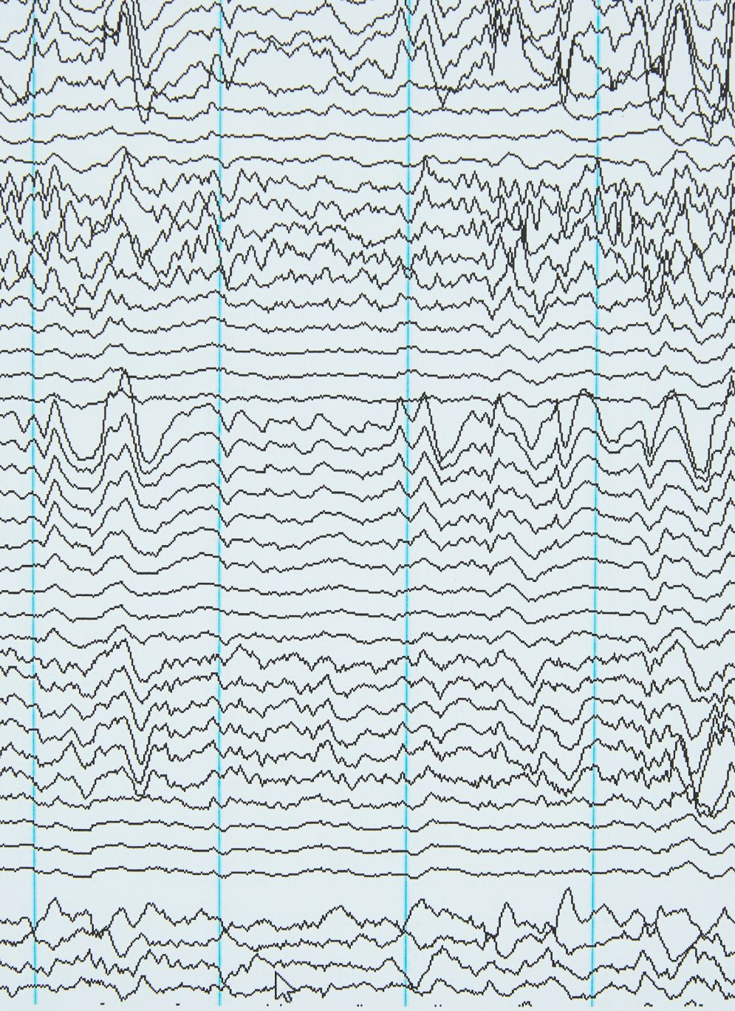
How does µ-LMS Works ?
The algorithm uses an iterative process to adjust the weights of the linear filter. At each iteration, the algorithm calculates the error between the predicted output and the desired output and adjusts the weights of the filter to minimize the error. The amount of weight adjustment is controlled by the step size parameter, also known as the learning rate.
The formula for the µ-LMS algorithm can be written as:
w(n+1) = w(n) + 2µe(n)x(n)
,where w(n) is the weight vector at iteration n, e(n) is the error at iteration n, x(n) is the input vector at iteration n, and µ is the learning rate.

Slide 4

Algorithm of Widrow-Hoff µ-LMS
The algorithm works as follows:
Initialize the weight vector w(0) to small random values.
For each input vector x(n), compute the predicted output y(n) as y(n) = w(n)x(n).
Compute the error e(n) as e(n) = d(n) - y(n), where d(n) is the desired output.
Update the weight vector using the formula w(n+1) = w(n) + 2µe(n)x(n).
Repeat steps 2-4 for all input vectors in the training set.
Repeat steps 2-5 until the error is sufficiently small or a maximum number of iterations is reached.

Slide 5
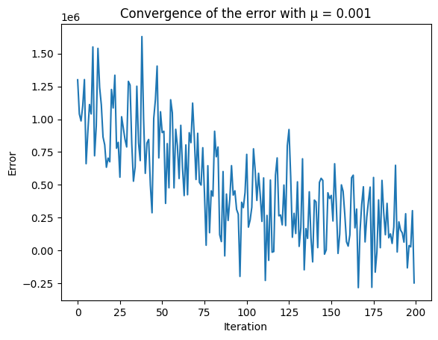
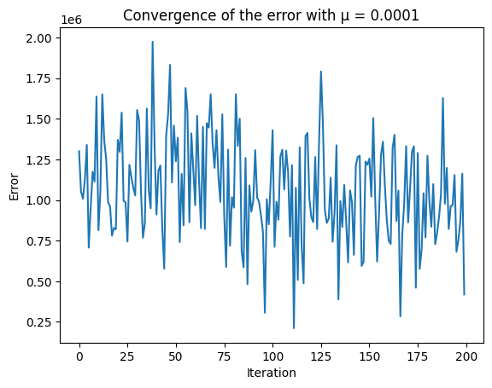
ERROR CONVERGENCE WITH µ = 0.001 & 0.00001

Slide 6
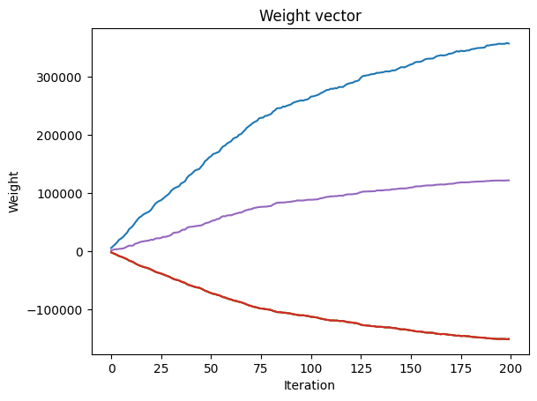
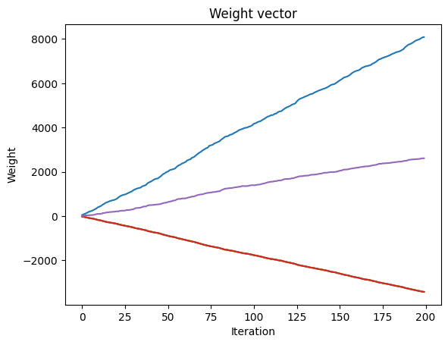
WEIGHT CONVERGENCE WITH µ = 0.001 & 0.00001

Slide 7
Merits and Demerits of µ-LMS
Merits:
Simplicity: The algorithm is relatively simple and easy to implement, making it suitable for real-time applications.
Fast Convergence: The algorithm can converge quickly to the optimal solution with a suitable choice of the learning rate parameter.
Low Computational Complexity: The algorithm has a low computational complexity, which makes it suitable for real-time applications with limited computational resources.
Robustness: The algorithm is robust to noise and can handle non-linear input-output mappings.
Demerits:
Sensitivity to Learning Rate: The algorithm can be sensitive to the choice of the learning rate parameter, which affects the rate of convergence and stability of the algorithm.
Local Minima: The algorithm can converge to local minima in the error surface, leading to suboptimal solutions.
Initialization: The algorithm requires initialization of the weight vector, which can affect the convergence behavior of the algorithm.
Lack of Memory: The algorithm does not have memory of past inputs and outputs, which can affect the accuracy of the predictions in non-stationary environments.

Slide 8
APPLICATIONS OF µ-LMS
Adaptive Filtering: The algorithm can be used for adaptive filtering of signals, such as noise cancellation and echo cancellation.
Prediction and Time Series Analysis: The algorithm can be used for predicting future values of a time series, such as stock prices, weather patterns, and traffic congestion.
Control Systems: The algorithm can be used for adaptive control of systems, such as robotics, aircraft control, and power systems.
Pattern Recognition: The algorithm can be used for pattern recognition and classification tasks, such as image and speech recognition.
Channel Equalization: The algorithm can be used for channel equalization in communication systems, such as equalization of a wireless channel or a cable modem.
Acoustic Echo Cancellation: The algorithm can be used for acoustic echo cancellation in teleconferencing and speech recognition systems.
Fault Detection and Diagnosis: The algorithm can be used for detecting and diagnosing faults in complex systems, such as automotive and industrial systems.
Adaptive Beamforming: The algorithm can be used for adaptive beamforming in communication systems, such as array signal processing and radar systems.

Slide 9
CONCLUSION
The Widrow-Hoff µ-LMS algorithm is a widely used method for updating the weights of a linear regression model.
It is well-suited for problems with correlated input features and many features relative to the number of training samples.
The algorithm is computationally efficient and can converge to a good solution with relatively few iterations. However, it is sensitive to the choice of learning rate, and may not be suitable for non-linear problems or problems with non-Gaussian noise.
Overall, the Widrow-Hoff µ-LMS algorithm is a valuable tool for machine learning practitioners in a variety of fields.

Slide 10
THANK YOU!

